Slide 1
PENGANTAR ALGORITMA NAÏVE BAYES
Joko Suntoro
jokosuntoro@usm.ac.id
SMS/Telp: 0822-4236-9670
WA/Telegram: 085-641-970-170
http://jokosuntoro.com

Slide 2

Joko Suntoro
SDN Pandean Lamper 03 Semarang (2001)
SMPN 32 Semarang (2004)
SMA Institut Indonesia Semarang (2007)
S1 Teknik Informatika Universitas Semarang (2010-2015)
S2 Teknik Informatika Universitas Dian Nuswantoro (2015-2016)
Tim Operasi dan Teknik, Domestic Gas PT Pertamina (Persero) (2008-sekarang)
Dosen dan Peneliti di Fakultas Teknologi Informasi dan Komunikasi Universitas Semarang
Peneliti dan Reviewer di Romi Satria Wahono (RSW) Intelligent System Research Group
Bidang Penelitian: Data Mining, Intelligent System dan Machine Learning

Slide 3
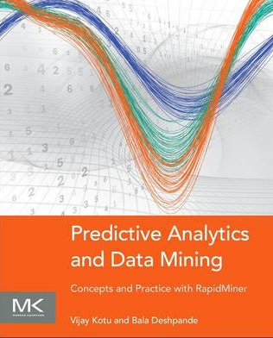

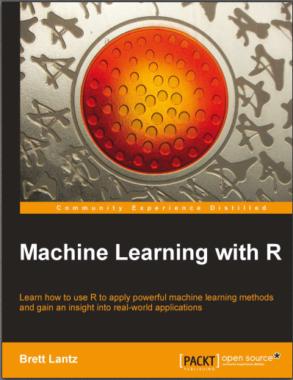
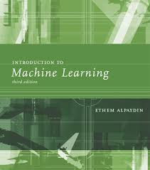
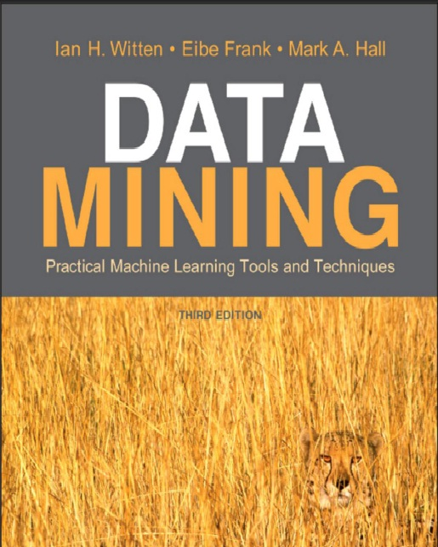
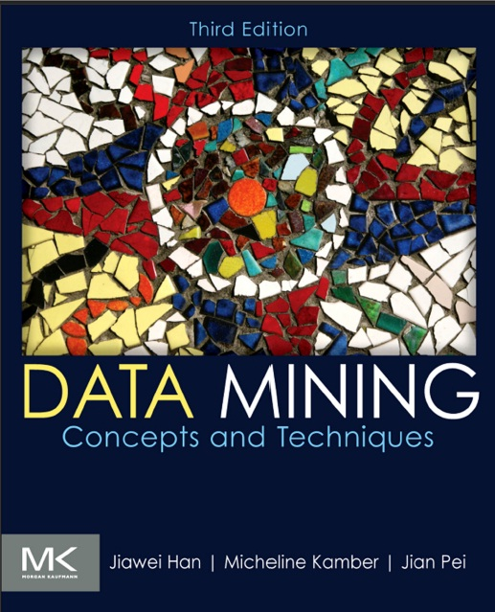
Textbooks

Slide 4
Definisi Algoritma Naïve Bayes
Bayesian classifiers are statistical classifiers. They can predict class membership probabilities such as the probability that a given tuple belongs to a particular class (Han & Kamber, 2012).
Notes:
Pengklasifikasi statistik.. Naïve bayes dapat memprediksi probabilitas keanggotaan kelas seperti probabilitas kelas pada record tertentu

Slide 5
Tahapan Algoritma Naïve Bayes
1. Siapkan dataset
2. Hitung jumlah class/label pada data training
3. Hitung jumlah kasus yang sama dengan class yang sama
4. Kalikan semua nilai hasil sesuai dengan data(X) yang dicari classnya

Slide 6
Tahapan Algoritma Naïve Bayes
Siapkan Dataset
Data Training Buys_Computer Dataset
Age | Income | Student | Credit Rating | Buys_Computer
youth | high | no | fair | no
youth | high | no | excellent | no
middle_aged | high | no | fair | yes
senior | medium | no | fair | yes
senior | low | yes | fair | yes
senior | low | yes | excellent | no
middle_aged | low | yes | excellent | yes
youth | medium | no | fair | no
youth | low | yes | fair | yes
senior | medium | yes | fair | yes
youth | medium | yes | excellent | yes
middle_aged | medium | no | excellent | yes
middle_aged | high | yes | fair | yes
senior | medium | no | excellent | no

Slide 7
Tahapan Algoritma Naïve Bayes
Data Testing (Data(X))
Age | Income | Student | Credit Rating | Buys_Computer
Senior | high | no | fair | ?
Contoh terdapat calon pembeli dengan kriteria sebagai berikut:
Age = senior
Income = high
Student = no
Credit_Rating = fair
Apakah calon pembeli tersebut akan membeli komputer?

Slide 8
Tahapan Algoritma Naïve Bayes
Teorema Naïve Bayes:
Dimana:

Slide 9
Tahapan Algoritma Naïve Bayes
2. Hitung Jumlah Class/Label Pada Data Training
Class 1 (C1) → Buys_Computer yes → 9
Class 2 (C2) → Buys_Computer no → 5
Total Record: 14
Maka:
P(C1) = 9/14 = 0.642857143
P(C2) = 5/14 = 0.357142857
Pertanyaan dengan kriteria:
Income=high
Student=no
Credit Rating=fair
Apakah akan membeli komputer?

Slide 10
Tahapan Algoritma Naïve Bayes
Hitung Jumlah Kasus Yang Sama dengan Class Yang Sama
Contoh penghitungan P(X|Ci) pada kasus Income dimana
i=1 dan i=2
P(Income=“high”|Buys_Computer=“yes”) = 2/9 = 0.22222222
P(Income=“high”|Buys_Computer=“no”) = 2/5 = 0.4

Slide 11
Tahapan Algoritma Naïve Bayes
Jika semua data aribut pada data training dihitung, maka:
Atribut | Parameter | yes | no
Age | youth | 0.222222222 | 0.6
Age | middle_aged | 0.444444444 | 0
Age | senior | 0.333333333 | 0.4
Income | low | 0.333333333 | 0.2
Income | medium | 0.444444444 | 0.4
Income | high | 0.222222222 | 0.4
Student | yes | 0.666666667 | 0.2
Student | no | 0.333333333 | 0.8
Credit Rating | fair | 0.666666667 | 0.4
Credit Rating | excellent | 0.333333333 | 0.6

Slide 12
Tahapan Algoritma Naïve Bayes
Kalikan semua nilai hasil sesuai dengan data(X) yang dicari class-nya
P(X|Buys_Computer=“yes”) = 0.016460905
P(X|Buys_Computer=“no”) = 0.0512
P(X|Buys_Computer=“yes”)*P(C1) = 0.010582011
P(X|Buys_Computer=“no”)*P(C2) = 0.018285714
Nilai “no” lebih besar daripada nilai “yes”. Sehingga pembeli dengan atribut X tidak membeli komputer

Slide 13
Referensi
Bache, K., & Lichman, M. (2013). UCI Machine Learning Repository. Retrieved from http://www.ics.uci.edu/~mlearn/MLRepository.html
Ethem Alpaydin. Introduction to Machine Learning. 3rd ed. MIT Press. 2014
Harrington, P. (2012). Machine Learning in Action. United States of America: Manning Publications Co.
Hofmann, M., & Klinkenberg, R. (2013). Rapid Miner Data Mining Use Cases and Business Analytics Applications. CRC Press Taylor & Francis Group
Ian H. Witten, Frank Eibe, Mark A. Hall. Data mining: Practical Machine Learning Tools and Techniques 3rd Edition. Elsevier. 2011
Jiawei Han and Micheline Kamber. Data Mining: Concepts and Techniques Third Edition. Elsevier. 2012
Lantz, Brett. Machine Learning with R. Packt Publishing. 2013
Larose, D. T. (2006). Data Mining Methods and Models. Data Mining Methods and Models. Canada: Willey Publishing, Inc.
Noth, Matthew. Data Mining for The Masses. Creative Commons Attribution. 2012
V. Kotu, Predictive analytics and data mining. USA: Elsevier Inc., 2015.
Wahono, R. S. (2016). Computing Courses Data Mining. Retrieved from http://romisatriawahono.net/dm/

